Slide 1

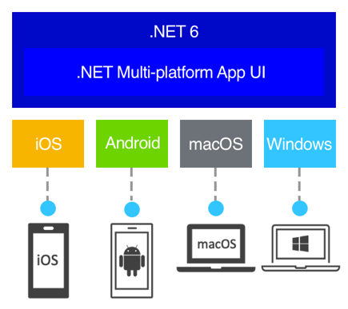
.NET MAUI
.NET Multi-platform App UI (.NET MAUI) lets you build native apps using a .NET cross-platform UI toolkit that targets the mobile and desktop form factors on Android, iOS, macOS, Windows, and Tizen.
Author: Vu.Truong

Slide 2
Agensda
What is .NET MAUI?
Supported Platforms
XAML Introduction
Single Project
Application Pattern
Fundamentals
Demo

Slide 3
What is .NET MAUI
Cross-platform framework for creating native mobile and desktop apps
Using C# and XAML
Develop apps from a single shared code-base
MAUI is open-source and is the evolution of Xamarin.Forms
Allow developer to implement as much of app logic and UI layout as possible in single code-base
* .NET Multi-platform App UI (.NET MAUI) is currently in preview

Slide 4
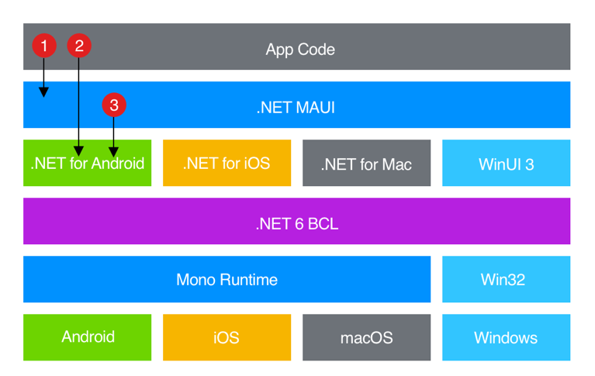
Why is .NET MAUI
Write cross-platform apps in XAML and C#, from a single shared code-base in Visual Studio
Share UI layout and design across platforms
Share code, tests, and business logic across platforms
Notes:
In a .NET MAUI app, you write code that primarily interacts with the .NET MAUI API (1). .NET MAUI then directly consumes the native platform APIs (3). In addition, app code may directly exercise platform APIs (2), if required.
.NET MAUI apps can be written on PC or Mac, and compile into native app packages:
Android apps built using .NET MAUI compile from C# into intermediate language (IL) which is then just-in-time (JIT) compiled to a native assembly when the app launches.
iOS apps built using .NET MAUI are fully ahead-of-time (AOT) compiled from C# into native ARM assembly code.
macOS apps built using .NET MAUI use Mac Catalyst, a solution from Apple that brings your iOS app built with UIKit to the desktop, and augments it with additional AppKit and platform APIs as required.
Windows apps built using .NET MAUI use Windows UI 3 (WinUI 3) library to create native apps that target the Windows desktop. For more information about WinUI 3, see Windows UI Library.

Slide 5
What .NET MAUI provides
Controls that can be used to display data, initiate actions, pick data...
Elaborate layout engine for designing pages
Data-binding, handlers, converters, triggers...
Essential cross-platform APIs for accessing native device features
Cross-platform graphics functionality
A single project system
.NET hot reload

Slide 6
Supported Platforms
Android 5.0 (API 21) or higher. For .NET MAUI Blazor apps, Android 6 (API 23) or higher is required
iOS 10 or higher. For .NET MAUI Blazor apps, iOS 11 or higher is required
macOS 10.13 or higher, using Mac Catalyst
Windows 11 and Windows 10 version 1809 or higher, using Windows UI Library (WinUI) 3
Additional platforms:
Tizen (Samsung)
Linux (supported by the community)

Slide 7
XAML
Stand for eXtensible Application Markup Language
Define UI using all views, layouts, pages...
Suited for use with the MVVM pattern
All XAML must be hand-written (use XAML hot-reload to view UI as edit)
The most important syntax features:
Property elements
Attached properties
Markup extensions

Slide 8
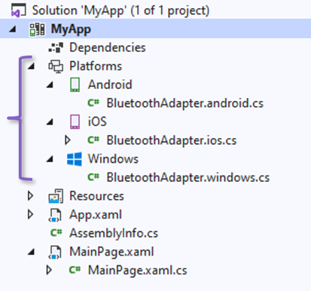
Single Project
NET MAUI single project is enabled using multi-targeting and the use of SDK-style projects in .NET 6
Features:
One project that targets multiple platforms and devices: android, iOS, macOS and Windows
One location to manage resources such as fonts and images, share resource files within the project
App manifest that specifies the app title, id and version
Access to platform-specific APIs and tools when required
A single cross-platform app entry point

Slide 9
Application Patterns
MVVM with C# and XAML (Model-View-ViewModel)
The view and the viewmodel are often connected through data bindings defined in XAML
The BindingContext for the view is usually an instance of the viewmodel
INotifyPropertyChanged: fire the PropertyChanged event whenever one of its properties changes
MVU with C# and Comet (Model-View-Update)
A model state object is the source of truth
Comet re-evaluate the View and Updating only what has changed

Slide 10
Fundamentals
Accessibility
App Lifecycle
App Startup
Dependency Injection
Platform Integration
Essentials

Slide 11
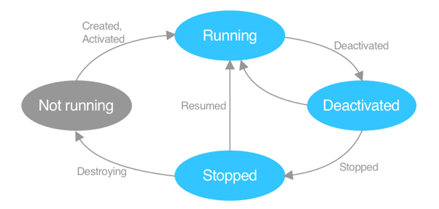
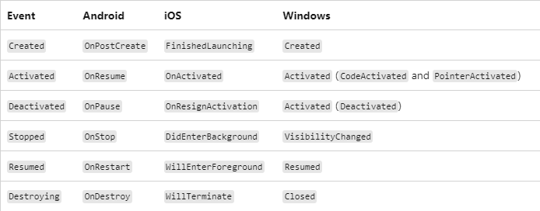
Fundamentals - App Lifecycle
App lifecycle
Cross-platform lifecycle events
Platform lifecycle events
Custom lifecycle events
Notes:
In the diagram, the gray oval indicates that the app isn't loaded into memory. The light blue ovals indicate that the app is in memory. Text on arcs indicates events that are raised by .NET MAUI, that provide notifications to the running app.

Slide 12
Fundamentals - Essentials
Access to sensors, such as the accelerometer, compass, and gyroscope on devices
Ability to check the device's network connectivity state, and detect changes
Provide information about the device the app is running on
Copy and paste text to the system clipboard, between apps
Pick single or multiple files from the device
Store data securely as key/value pairs
Utilize built-in text-to-speech engines to read text from the device
Initiate browser-based authentication flows that listen for a callback to a specific app registered URL
Notes:
In the diagram, the gray oval indicates that the app isn't loaded into memory. The light blue ovals indicate that the app is in memory. Text on arcs indicates events that are raised by .NET MAUI, that provide notifications to the running app.

Slide 13
Fundamentals
Shell: provide the fundamental features that most apps require
Data binding: link a pair of properties between two objects, target and source
Property
Command
Binding Context
Gestures: drag drop, pan, swipe, tap...
Resource Dictionary: define styles, colors, converters, controle templates...
MessagingCenter: the publish-subscribe pattern
Allowing message-based communication between components
Method: Send, Subscribe, Unsubscribe
Others: behaviors, properties, handlers, templates, triggers, converters

Slide 14
User Interface
Layouts
Pages
Menu bar (WinUI)
Popup: Alert, ActionSheet, Prompt
Navigation: Routes and Stacks
Views
Built-in Controls or widgets
Content Views
Customize Control
Others:
Animation, Brushes, Graphic, Font, Images
Styles, Theming, Visual States

Slide 15
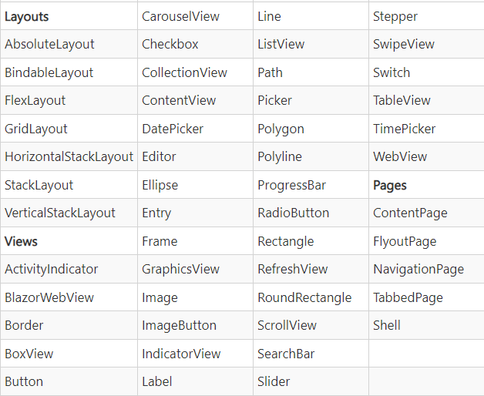
User Interface

Slide 16
Resource References
Links
https://docs.microsoft.com/vi-vn/dotnet/maui/
https://devblogs.microsoft.com/dotnet/dotnet-maui-rc-1/
https://github.com/dotnet/Comet
https://github.com/dotnet/maui

Slide 17
Demo

Slide 18
Q & A

Slide 19
THANK YOU!!!

